Slide 1
WHMIS Training
Heritage Reforestation 2016

Slide 2
What is WHMIS?
Im not writing out the acronym …
WHMIS is legislation that establishes a uniform system to identify and control hazardous materials in the workplace.
It is consistent with the worker’s “right to know” about hazards in the workplace.
The ‘supplier’, ‘employer’, and ‘worker’ all have legal responsibilities under the act.
Under the act, employers must provide training to employees who will handle hazardous materials.

Slide 3
To be WHMIS Certified …
To be WHMIS certified you only need to know information about the controlled products you will encounter in the workplace.
If you can answer the following four questions about the controlled products in your workplace, you are adequately trained:
  What are the hazards of the product you are using?
  How do you protect yourself?
  What do you do in case of an emergency or spill?
  Where do you get more information on this product?
After completing this ‘course’ and correctly answering the quiz questions you are WHMIS certified for HRI 2015.
A certificate will be issued to you before operations start.

Slide 4
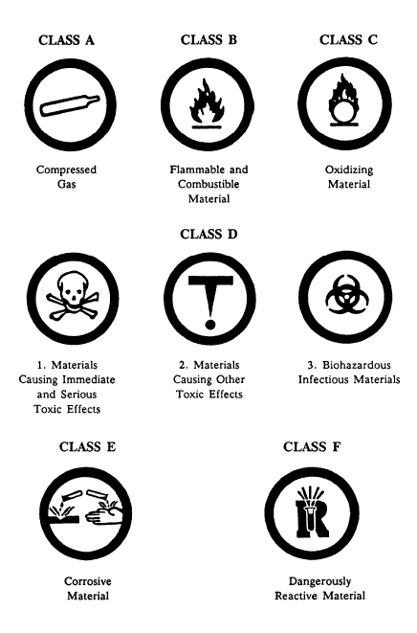
Labelling
An important part of controlling a hazardous substance is labelling.
All ‘suppliers’ of controlled substances must provide hazard information through labelling the containers (see right) and through MSDS (next slide).
More than one symbol may appear with a product.
Learning these symbols will tell you ‘at a glance’ the hazards of the product you will be using.
Always ensure controlled products are in proper containers, and adequately labelled.

Slide 5
MSDS – everything you need to know …
Please Review the MSDS at your convenience
Section 1 – Product and Company Information
Section 2 – Composition and Ingredients
Section 3 – Hazards Identification
  Potential health effects from relevant routes of exposure
Section 4 – First Aid
  Describes First Aid for accidental overexposure to : eyes, skin, inhalation, ingestion,
Section 5 – Fire Fighting Measures
Section 6 – Accidental Release Measures
  Procedures for dealing with a spill
Section 7 – Handling an Storage
Section 8 – Exposure Controls/PPE
Section 9 – Physical and Chemical Properties
  Appearance, odour, pH, etc.
Section 10 – Stability and Reactivity
Section 11 – Toxicological Info
  Effects of exposure, irritancy
Section 12 - Ecological Information
Section 13 – Disposal Considerations
Section 14 – Transport Information
  Relates product to TDG
Section 15 – Regulatory Information

Slide 6
The hazardous materials in our workplace:
Diesel
Gasoline
Propane
Engine Oil
Engine Coolant
Bleach
What are the hazards of the product you are using?
How do you protect yourself?
What do you do in case of emergency or spill?
Where do I get more information on this product?

Slide 7

Diesel
First Aid
Flush eyes for 15 min
Remove contaminated clothing, wash irritated skin gently with running water and soap.
Spill
ELIMINATE Ignition Sources
Stop Leak
Contain spill using absorbent materials
Hazards
Eye contact will cause mild irritation.
Skin contact will cause moderate to severe irritation and drying.
Inhalation will cause symptoms of nausea
Flammable liquid, keep away all sources of ignition.
Protection
Wear long sleeves and pants
If splashing is likely wear gloves and eye protection
Only handle product in well ventilated area.

Slide 8

Gasoline
First Aid
Flush eyes for 15 min get medical attention.
Remove contaminated clothing, flush with water for 15 min.
Spill
ELIMINATE Ignition Sources
Stop Leak
Contain spill using absorbent materials
Hazards
Eye contact will cause mild irritation.
Skin contact will cause moderate to severe irritation.
Inhalation will cause symptoms of nausea
Flammable Liquid keep away all sources of ignition.
Protection
Wear long sleeves, pants, and impervious gloves
If splashing is likely wear eye protection
Do not handle or store indoors.

Slide 9

Propane
First Aid
Flush eyes for 15 min. get medical attention immediately.
Wash frost bitten areas with water, do not remove clothing.
Spill
Evacuate area immediately.
Ensure adequate ventilation.
Eliminate all sources of ignition.
If safe to do so, stop source of gas.
Hazards
Extremely Flammable gas, under high pressure.
Inhalation a hazard
Exposure may cause frostbite
Protection
Wear long sleeves and pants.
Always wear eye protection when changing propane tanks.
Avoid inhalation, be aware of odour.

Slide 10

Bleach
First Aid
Flush eyes for 15 min. call poison centre for treatment advice
Remove contaminated clothing, wash irritated skin gently with running water and soap.
Spill
Toxic to fish, prevent from entering waterbodies
Prevent further leakage.
Contain spill using absorbent materials
Hazards
Eye contact will cause serious damage.
Skin contact will cause moderate to severe irritattion.
Protection
Wear rubber or neoprene gloves.
If splashing is likely wear eye protection with face shield.

Slide 11
Quiz
List the 6 controlled substances you might encounter this summer.
List the 6 classes of hazardous materials defined by WHMIS.
Which seems like a more hazardous substance, Gasoline or Diesel?
Must gloves be worn when rinsing your dishes in the bleach water?
What is the ‘biggest’ difference between gasoline and propane?
What needs to be done to a red ‘jerry’ container in order to safely store diesel in it?
Please send back your answers in a word document to dcollins@heritageinc.ca. After correctly answering these questions you are now WHMIS certified! … Get excited

